Slide 1


Fog and Edge Computing
Project: Water Tank Monitoring System
Name: Afaq Habib
Student ID: x24154296

Slide 2
Edge Layer (sensors)
Sensors: I used four sensors in my project they are Water Level, Flow Rate, Temperature, and pressure.
Deployment: I deploy my Edge Script on Elastic Beanstalk for continuous running to generate random data.

Slide 3
Fog Layer
Every 20 seconds the Fog Received data from AWS IOT.
The fog layer filter and check sensor data (WaterLevel, Flow Rate, Temperature, and pressure) and generate alerts according to the data.
Send data to AWS RDS.

Slide 4
AWS Services
I used three AWS services.
Elastic Beanstalk
IOT
AWS RDS

Slide 5

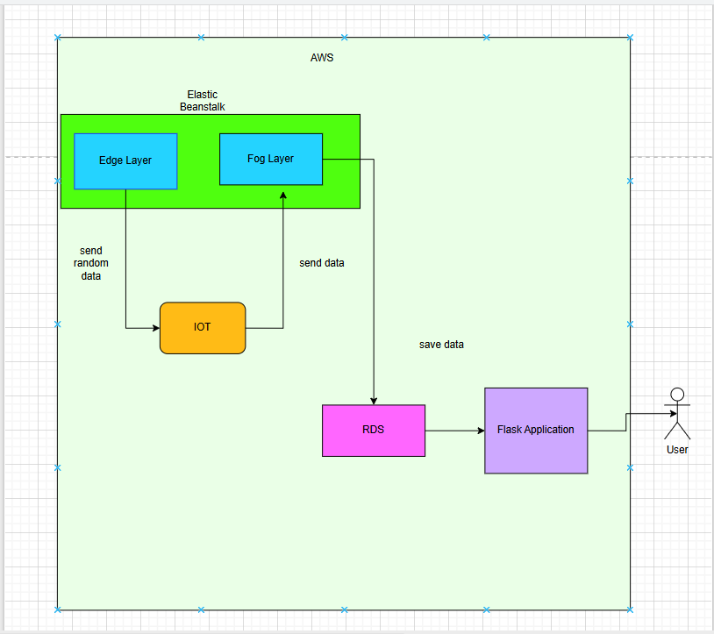
Application Architecture

Slide 6
Application and GitHub Links
Application Link:
Iotapplication-env.eba-wc6yp5ey.us-east-1.elasticbeanstalk.com
GitHub Link:
https://github.com/afaqhabib01/fogandedge_project.git

